Slide 1
Bang For Your Taxpayer Buck
Teacher Ratings in the Albany School District

Slide 2
In 2015 the Governors’ office released a report on the failing state of education in New York State. Here were some key points…
https://www.governor.ny.gov/sites/governor.ny.gov/files/atoms/files/NYSFailingSchoolsReport.pdf

Slide 3
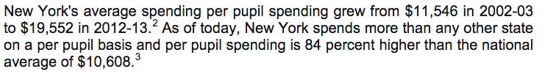

Slide 4
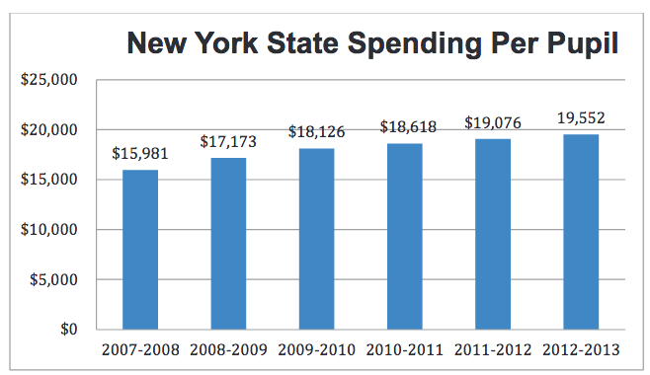

Slide 5
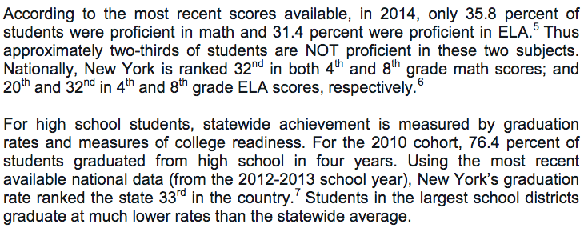

Slide 6
Given this Unsettling Trend, Our Team wanted to Use NY State DATA Verify these findings.

Slide 7
Given this Unsettling Trend, Our Team wanted to Use NY State DATA Verify these findings.
https://data.nysed.gov/downloads.php

Slide 8
However Two things became clear after Reviewing the Available Data: 1. The Data Was too unruly/incomplete to evaluate the correlation between per pupil expenditure and education outcomes. 2. WE could better contrast Teacher Evaluations ratings and per pupil expenditure. This would be interesting Contrasting this correlation with the aforementioned statistics.

Slide 9
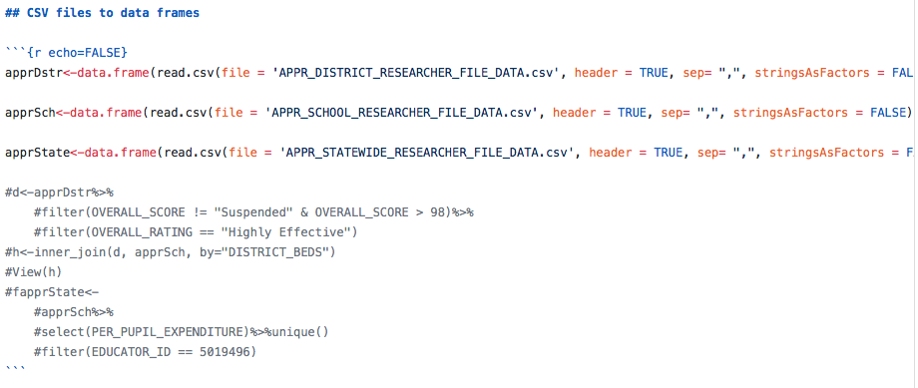
First We Joined The Data Using the following methods.

Slide 10
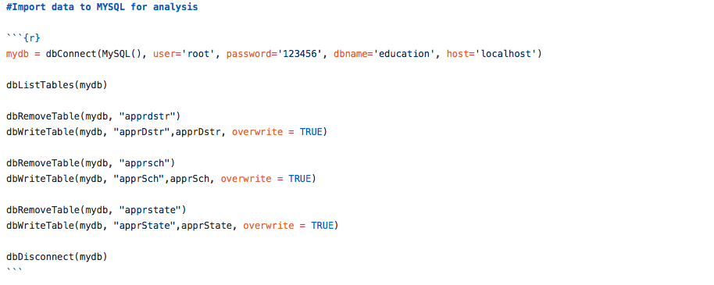

Slide 11
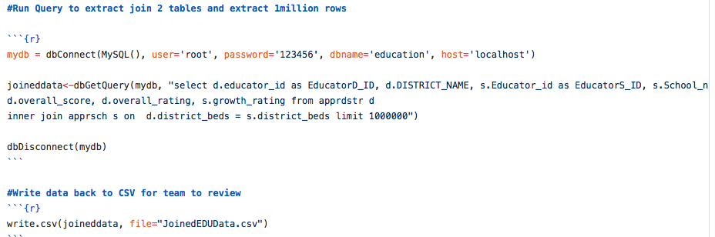

Slide 12
Note We were only able to merge The Data for the Albany School District.

Slide 13
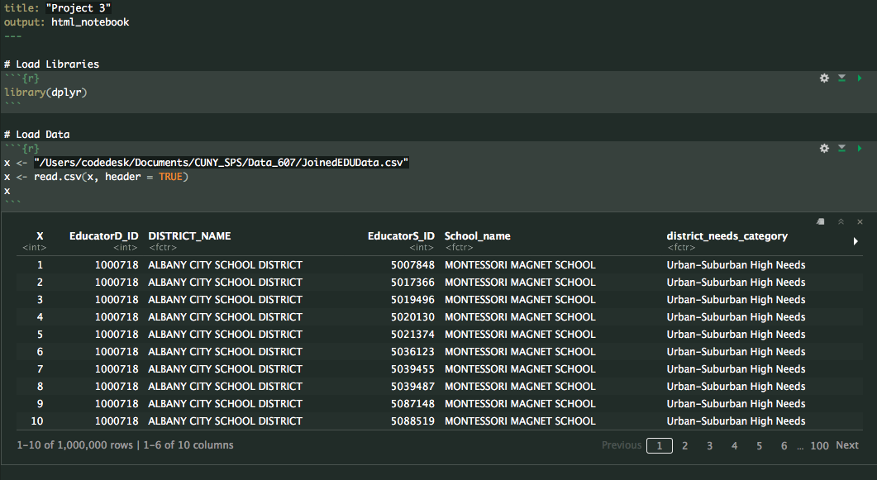
Then We Cleaned the Data and prepared it for Analysis.

Slide 14
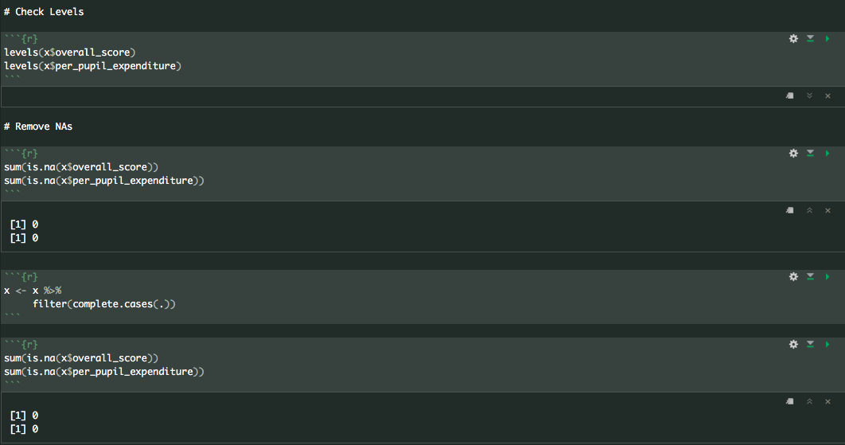
Then We Cleaned the Data and prepared it for Analysis.

Slide 15
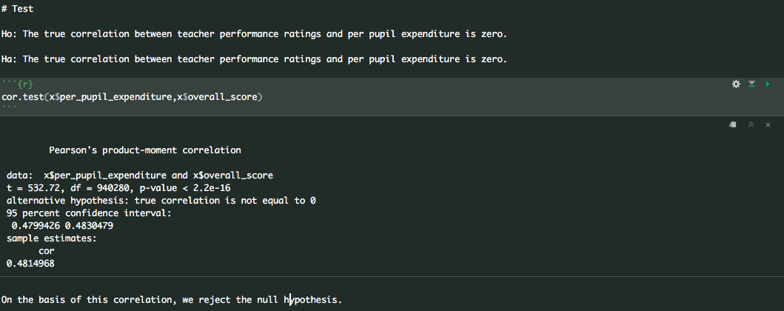
Then we analyzed the data.

Slide 16
Two Caveats: 1. Per pupil Expenditure was essentially a binary, since Expenditure only had two levels “Medium” and “High”. As Such this could have contributed to the strength of the correlation. 2. There were about 60K “Suppressed” Rattings which were removed for this analysis. This was still less than 10% of the total obseravtions.

Slide 17
Questions?

